Slide 1
Summer Internship Programme
Organization- Commerce Robotics Inc.
Tokyo, Japan
Role- Software Development Intern
Project: Meetgram - A Centralized Meeting Management Tool

Slide 2
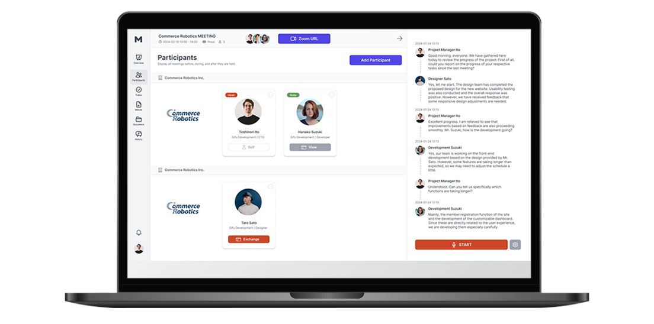
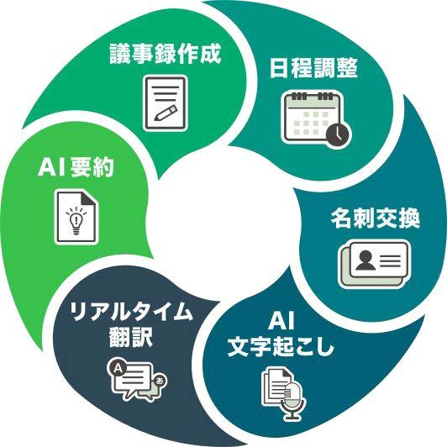

About Meetgram
Easy-to-schedule online
meetings platform
Real-Time Speech-to-Text
Translation Service
AI-powered meeting minutes
Meeting Chat History
Source: https://www.meet-gram.com/

Slide 3
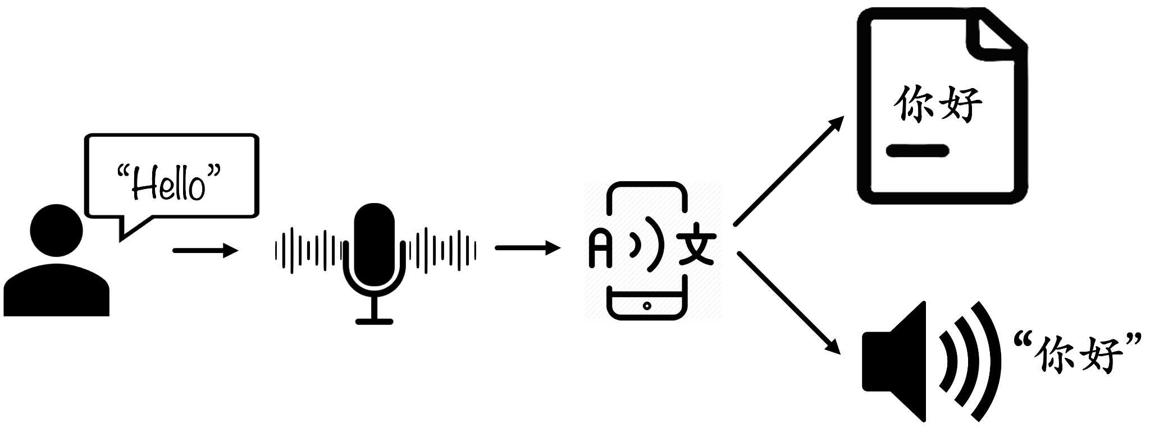
Contributions and Tasks
Speech-to-Text Service Optimization:
On-Speech End Translation Real-time Translation
Voice-Activity Detection and Echo-filtering
Speaker Diarization
User Interface (UI) Enhancement for Chat System
Speech-to-Translated Text

Slide 4
Key Challenges and Solution
Solution
Challenges
01
Silero VAD: pre-trained VAD module. Modifying the above module by chunking the voice input for real-time conversion. | Learning Typescript. Integrating the modified version of module within the project. (Compatibility)
x | x
x | x
Real-time Speech-To-Text Optimization
02
Testing several Speaker Diarization APIs such as Pyannote, Nvidia Nemo and comparing results (performance and price) | Understanding the modules. Error handling. Cost management. Scalability issues.
Speaker Diarization
03
Old-boring basic UI transformed in modern, flexible and responsive UI following the best practices | Learning Vue.Js Adhering to UI/UX best practices. User feedback integration
UI Enhancement for Chat

Slide 5
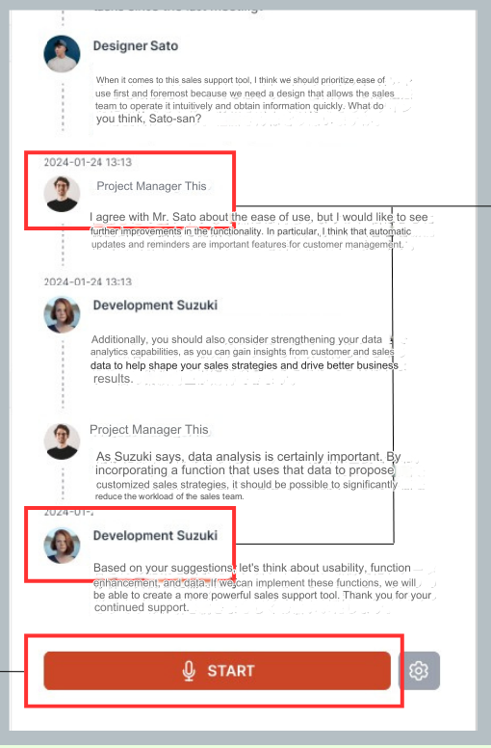
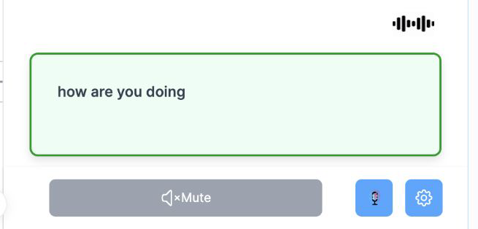
Results
Chat System UI Updation

Slide 6
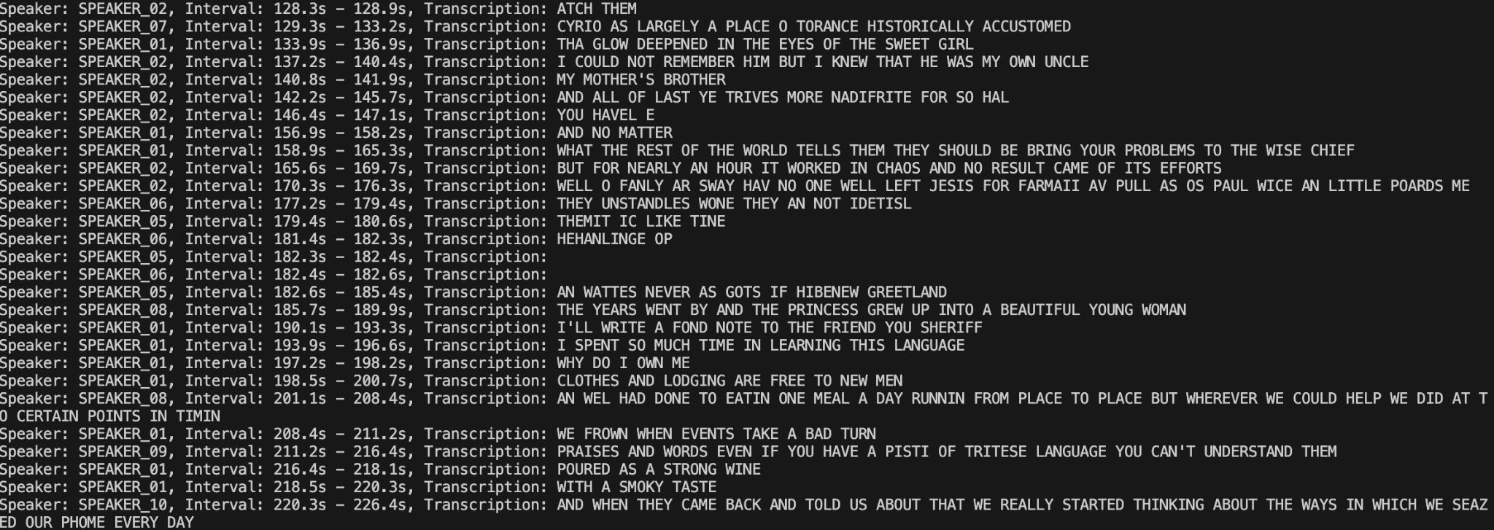
Results (Contd.)
Speaker Diarization output on sample audio file
(10 speakers on single mic)

Slide 7
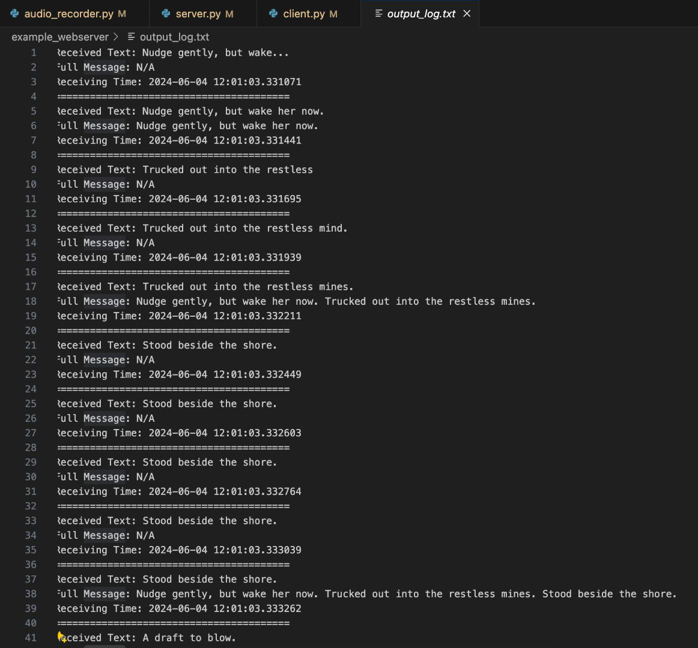
Results (Contd.)
1
Chunks of speech sent to client(user) as real-time transcribed text
Full sentence(stabilised text) being sent to client(user)
2
Fig. Real-time Speech-To-Text Transcription and Translation

Slide 8
The Impact
Real-Time Speech Translation
Intelligent Task Management
Conversion of audio from one language to another in real-time while the user is speaking.
Automatic scheduling of tasks and agendas from the AI generated meeting notes
Breaking Language Barriers
Accelerate Global partnerships
Highly customizable service
Elimination of Manual Task tracking
Shorter, purpose driven meetings
Ease of retrieval of tasks

Slide 9
Learnings and Insights
Learning the most trendy
tech-stack
AI, Cloud services, Docker, Vue.js and much more
Work-life balance
Managing the daily chores in a completely foreign country
Collaboration across disciplines
Both in-team as well as across teams
Finding the path to the best optimal solution
Based on cost management as well as output quality
Enhanced problem-solving and time management skills
Challenges test our perseverance and consistency under time limited environment

